Slide 1
Superpave Study Group
Math

Slide 2
Summary
Gmb – Bulk Specific Gravity of compacted asphalt sample. (T166)
Abs - Absorption
Gmm – Maximum Specific Gravity of Loose Mix Asphalt. (T209)
Va – Air Voids of a compacted asphalt sample. (T269)
Gse – Effective Specific Gravity of Aggregate.
VMA – Percent Voids in Mineral Aggregate.
Gsb – Bulk Specific Gravity of the combined Aggregate.
VFA – Percent Voids filled with Asphalt

Slide 3
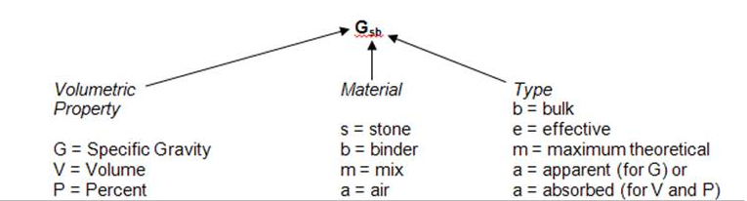
Gsb

Slide 4

1. Bulk Specific Gravity (Gmb)
Determine the Gmb of the compacted specimen:
Dry Mass 4555.6 g = A
SSD Mass _ 4562.4 g = B
Submerged Mass 2620.0 g = C
Formula to use:
Round to nearest 0.001

Slide 5
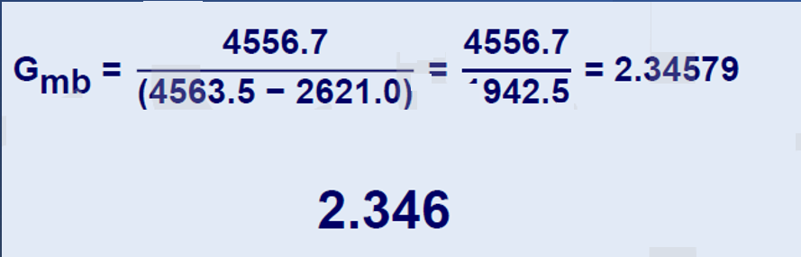
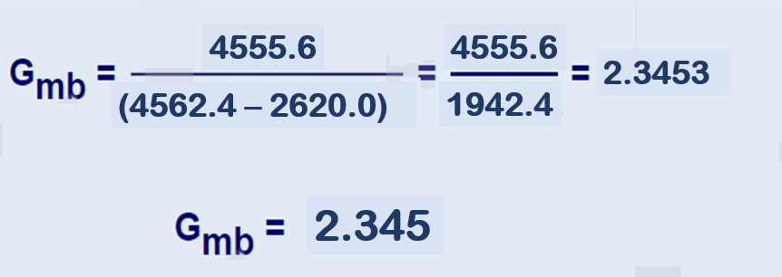

ANSWER #1
4555.6
4555.6
2.3453
(4562.4 – 2620.0)
1942.4
2.345

Slide 6
1b. Bulk Specific Gravity (Gmb)
Determine the Gmb of the compacted specimen:
Dry Mass 4548.2 g = A
SSD Mass 4551.9 g= B
Submerged Mass 2615.8 g= C
Formula to use:
Round to nearest 0.001
Gmb = 2.355

Slide 7
ANSWER #1b
4548.2
4548.2
=
=
2.35548
(4551.9 - 2621.0)
1930.9
2.355

Slide 8

2. % Absorption (Abs)
Determine the % absorption of a compacted specimen:
Dry Mass 4573.6_ g = A
SSD Mass _ 4585.1_ g = B
Submerged Mass 3633.0 g = C
Formula to use:
Round to nearest 0.01%
% Abs =
X 100
Note: AASHTO T166 states if the % Absorption is greater than 2%,
Gmb for the specimen is not valid, an alternative Method can be use:
AASHTO T275 or AASHTO T331.

Slide 9
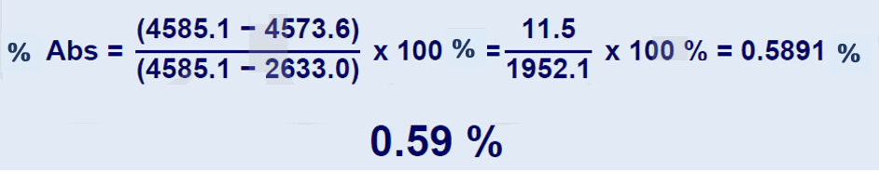
ANSWER #3
ANSWER #2
Absorption =

Slide 10
2b. % Absorption (Abs)
Determine the % absorption of a compacted specimen:
Dry Mass 4555.2_ g = A
Submerged Mass _ 4567.6_ g = B
SSD Mass 2615.3 g = C
Formula to use:
Round to nearest 0.01%
% Abs =
X 100
Absorption = 0.64%

Slide 11
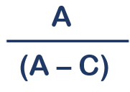
3. Maximum Specific Gravity (Gmm)
Determine the Gmm of a loose mix (RICE)
Dry Mass 1785.4_ g = A
Submerged (Rice + Bowl) Mass _ 2358.6_ g = C
Submerged Bowl Mass 1325.0 g = C
Formula to use:
Round to nearest 0.001
1033.6g
2358.6 – 1325.0 C = 1033.6
Gmm =
X 100

Slide 12
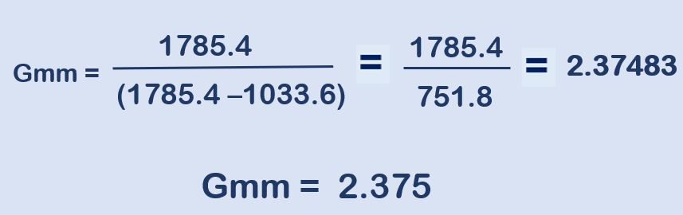
ANSWER #3

Slide 13
3b. Maximum Specific Gravity (Gmm)
Determine the Gmm of a loose mix (RICE)
Dry Mass 1806.2_ g = A
Submerged (Rice + Bowl) Mass _ 2349.9_ g = C
Submerged Bowl Mass 1315.0 g = C
Formula to use:
Round to nearest 0.001
1034.9g
2349.9 – 1315.0 C = 1034.9
Gmm =
X 100
Gmm = 2.342

Slide 14
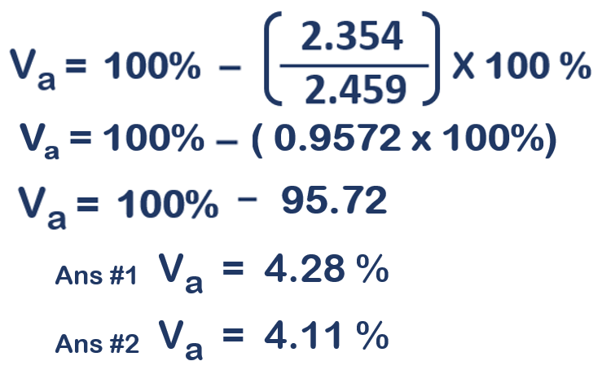
ANSWER #4
ANSWER #4b

Slide 15
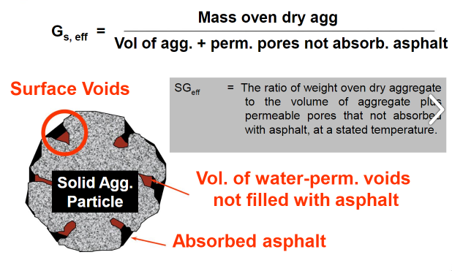
4. Effective Specific Gravity of Aggregate (G_{se})
The ratio of weight oven dry aggregate
To the volume of aggregate plus
Permeable pores that not absorbed
With asphalt, at a stated temperature.

Slide 16
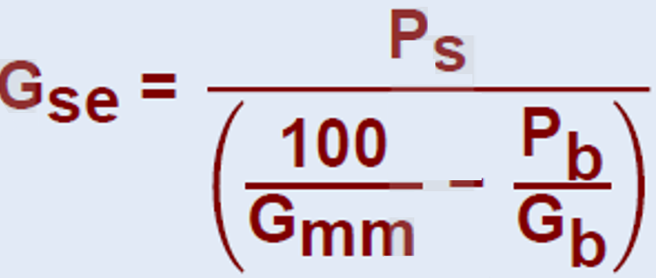
4. Effective Specific Gravity of Aggregate (G_{se})
Determine Gse of the mixture.
P_{b} = 4.8 %
G_{mm} = 2.358
G_{mb} = 1.038
Formula
Round to nearest 0.001

Slide 17
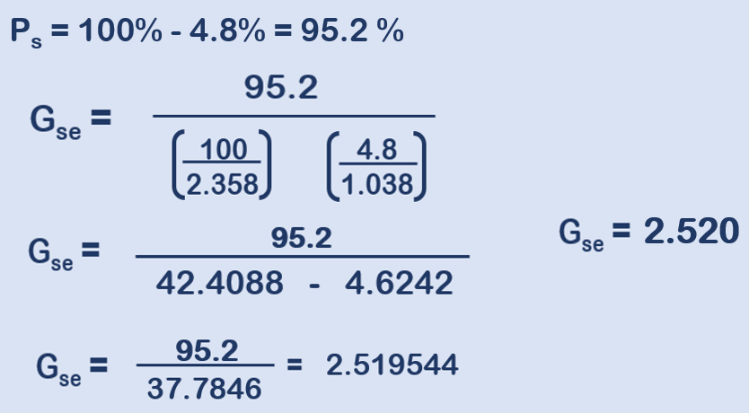
ANSWER #5

Slide 18
5b. Effective Specific Gravity of Aggregate (G_{se})
Determine Gse of the mixture.
P_{b}= 5.7 %
G_{mm}= 2.413
G_{bulk}= 1.032
Formula
Round to nearest 0.001
Gse = 2.625

Slide 19
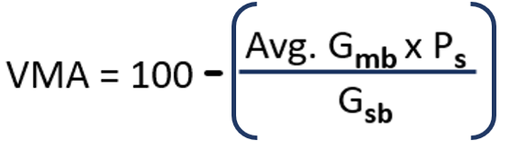
6. Calculate Voids in Mineral Aggregate (VMA).
Determine % VMA of the mixture.
P_{s}= 94.0%
Average G_{mb} = 2.304
G_{sb} = 2.612
Formula
Round to nearest 0.1%

Slide 20
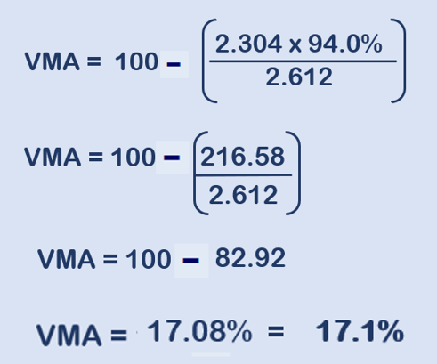
ANSWER #6

Slide 21
6b. Calculate Voids in Mineral Aggregate (VMA).
Determine % VMA of the mixture.
P_{s}= 94.02%
Average G_{mb} = 2.411
G_{sb} = 2.708
Formula
Round to nearest 0.1%
Gse = 16.29% = 16.3%

Slide 22
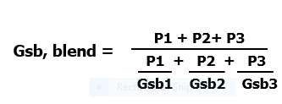
7. Calculate the combined (weighted average)Gsb of the aggregate blend shown on the JMF on the next slide.
Determine Gsb of the mixture.
Formula =
Round to nearest 0.001
P = % of each aggregate
Gsb = Bulk specific gravity of each aggregate

Slide 23
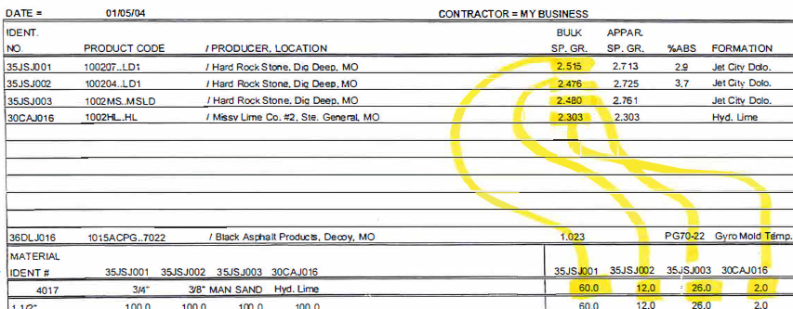
2.512
2.425
2.418
2.288
64.0 11.0 22.0 3.0
64.0 11.0 22.0 3.0

Slide 24
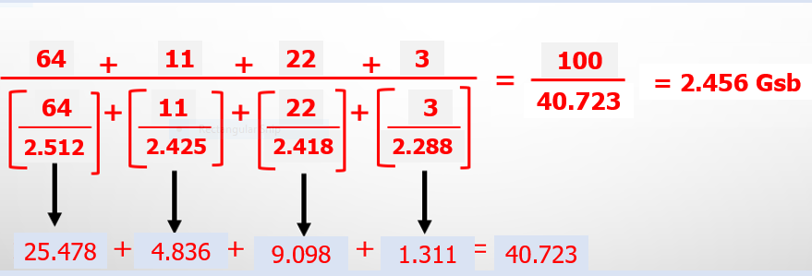
ANSWER #7

Slide 25
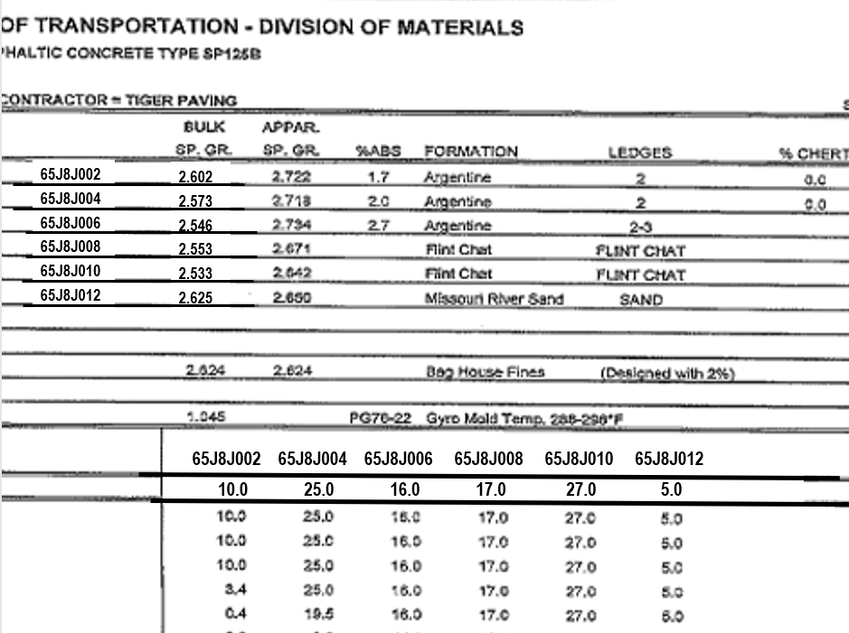
7b. Determine the Gsb of this mixture…
Gsb = 2.560

Slide 26
7. Calculate the percent voids filled with asphalt, VFA.
Determine VFA of the mixture.
Formula = VFA, % = 100 X
Round to nearest 0.1
( VMA – Va )
VMA
Va = % Voids in Total Mix = 3.8%
VMA = Percent voids in Mineral Aggregate = 14.8%

Slide 27
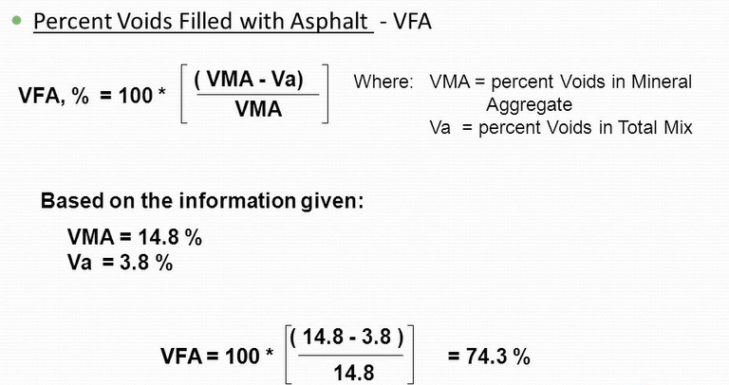
ANSWER #7
Round to nearest 0.1

