Slide 1
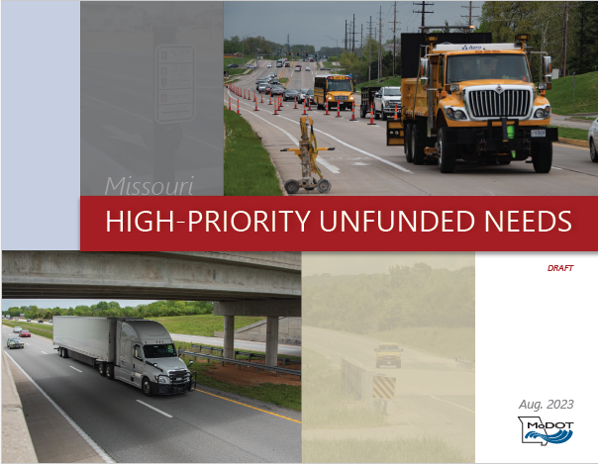
UNFUNDED NEEDS:
PUBLIC MEETINGS
Northwest

Slide 2


Funding Distribution
Total Distributed Construction Program Funds
$1,508 Million
To insert an image in the place of this, right click and choose “Change Picture”
Fiscal Year 2024 Amounts
Safety
$58 Million
Asset Management
$829 Million
Distributed based on:
System size
System usage
Fatalities/serious injuries
Population
Employment
System Improvements
$621 Million
*Does not include I-70 or other Legislatively Designated and Funded Initiatives

Slide 3
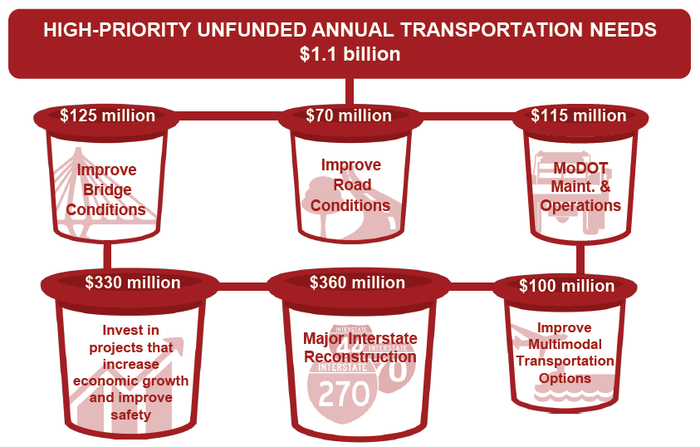
THE NEEDS

Slide 4
THE OUTCOME
$4.7 billion of road and bridge needs in new updated document
  Three tiers
  Tier one = could be accomplished in the current STIP horizon
$1 billion of multimodal needs

Slide 6
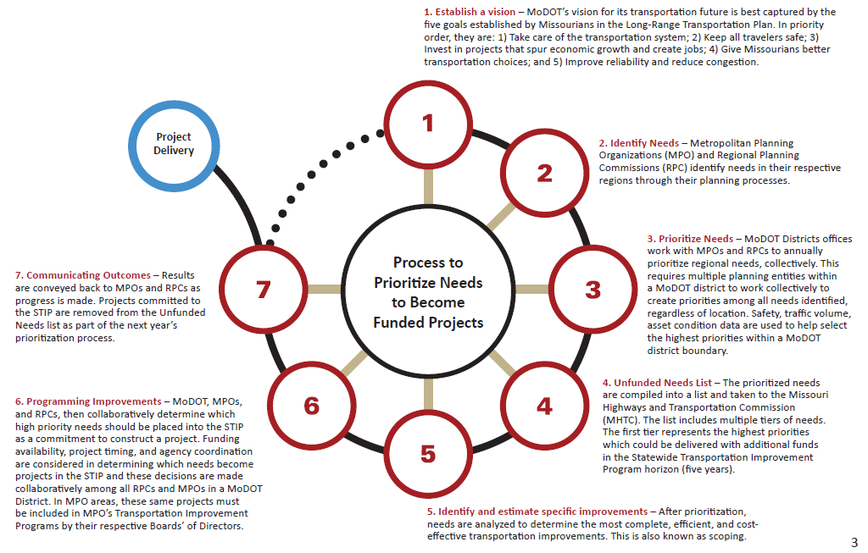
THE PROCESS
Establish a vision
Project
delivery
Identify needs
Communicating outcomes
Prioritize needs
Programming improvements
Unfunded needs list
Identify and estimate specific improvements

Slide 7
Prioritize needs – MoDOT district offices work with MPOs and RPCs to annually prioritize regional needs, collectively. This requires multiple planning entities within a MoDOT district to work collectively to create priorities among all needs identified, regardless of location. Safety, traffic volume, asset condition data are used to help select the highest priorities within a MoDOT district boundary.
3

Slide 8
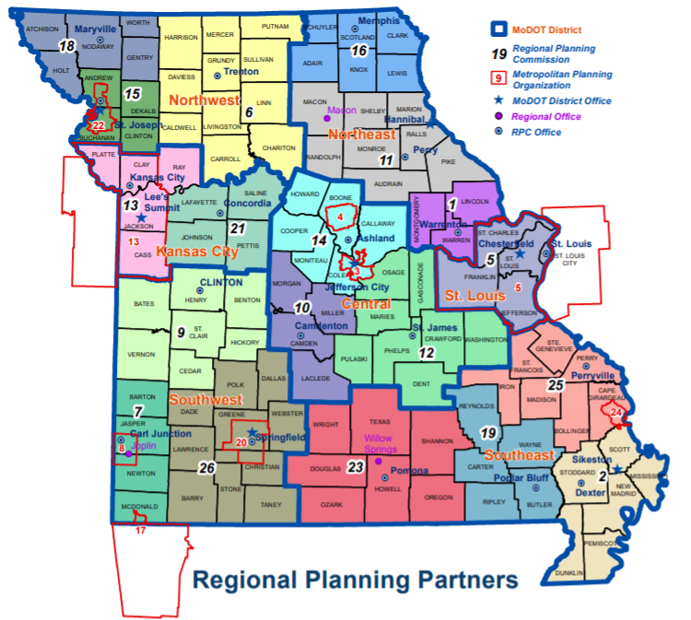
REGIONAL PLANNING PARTNERS

Slide 9
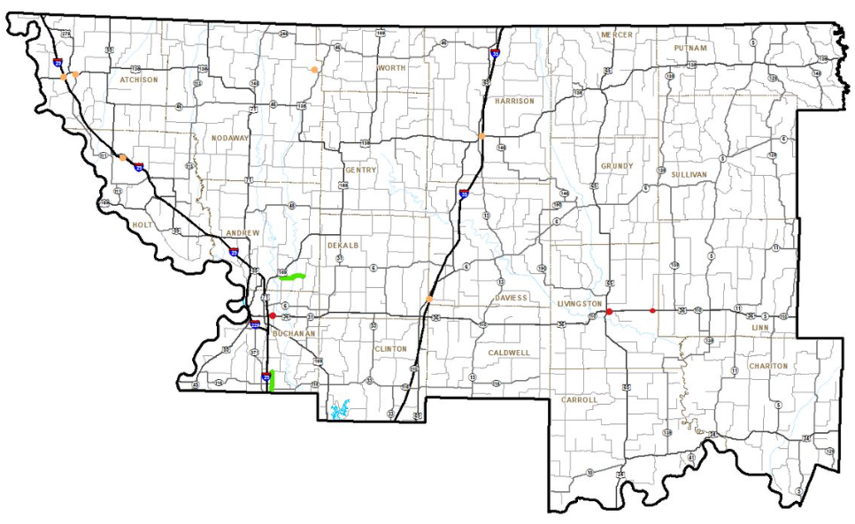
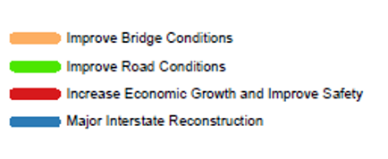
HIGH-PRIORITY UNFUNDED ROAD AND BRIDGE NEEDS
Tier 1 - $26 million
NORTHWEST - TIER 1

Slide 10
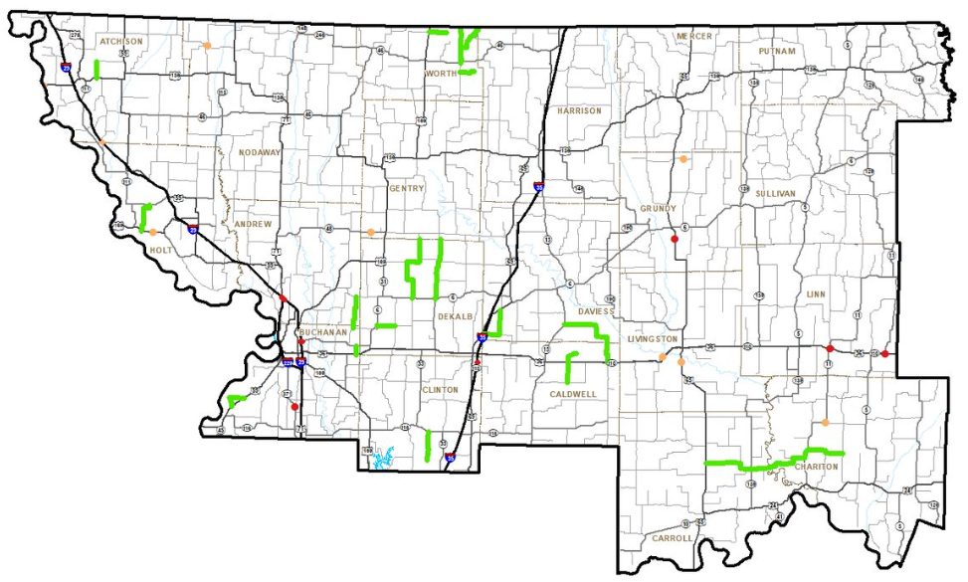
HIGH-PRIORITY UNFUNDED ROAD AND BRIDGE NEEDS
Tier 2 - $93 million
NORTHWEST - TIER 2

Slide 11
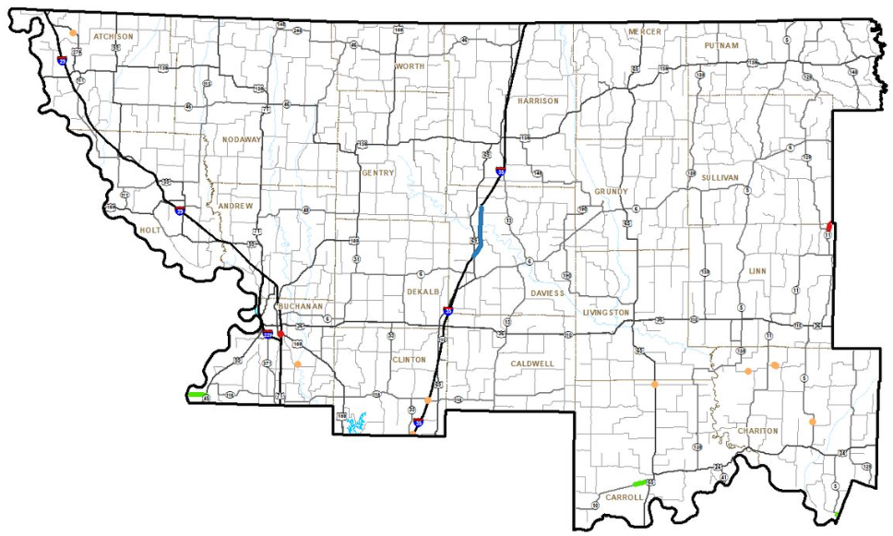
HIGH-PRIORITY UNFUNDED ROAD AND BRIDGE NEEDS
Tier 3 - $95 million
NORTHWEST - TIER 3

Slide 12
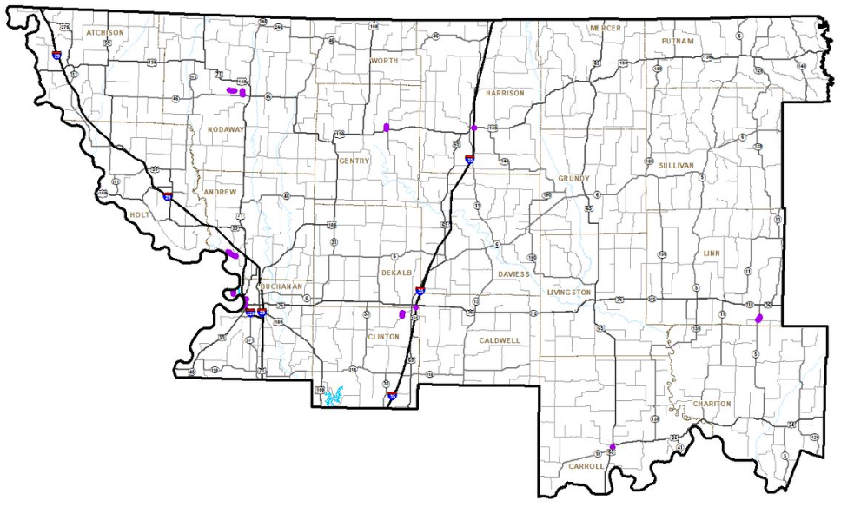

HIGH-PRIORITY UNFUNDED MULTIMODAL NEEDS
Multimodal - $50 million
NORTHWEST - MULTIMODAL

Slide 13
NORTHWEST SUMMARY
TIER | IMPROVE BRIDGE CONDITIONS | IMPROVE ROAD CONDITIONS | INCREASE ECONOMIC GROWTH & IMPROVE SAFETY | MAJOR INTERSTATE RECONSTRUCTION | IMPROVE MULTIMODAL TRANSPORTATION OPTIONS | TOTAL
TIER 1 | $14,813 | $1,207 | $9,685 |  |  | $25,705
TIER 2 | $40,263 | $16,331 | $36,211 |  |  | $92,805
TIER 3 | $13,578 | $16,870 | $23,215 | $41,245 |  | $94,908
MULTI-MODAL |  |  |  |  | $49,589 | $49,589
TOTAL | $68,654 | $34,408 | $69,111 | $41,245 | $49,589 | $263,007
Amounts in $1,000 in 2023 Dollars (Uninflated)

Slide 14
STATEWIDE - TOTALS BY PRIORITY
DISTRICT | TIER 1 | TIER 2 | TIER 3 | MULTIMODAL | MAJOR BRIDGE | STATEWIDE | GRAND TOTAL
NORTHWEST | $25,705 | $92,805 | $94,908 | $49,589 | $113,200 | - | $376,207
NORTHEAST | $23,000 | $94,000 | $94,000 | $47,000 | $51,000 | - | $309,000
KANSAS CITY RURAL | $15,516 | $63,410 | $63,240 | $33,186 | - | - | $175,352
KANSAS CITY URBAN | $100,000 | $371,525 | $349,514 | $198,500 | $59,000 | - | $1,078,539
CENTRAL | $59,890 | $225,927 | $225,887 | $112,960 | - | - | $624,664
ST. LOUIS | $207,000 | $731,770 | $683,650 | $348,307 | $108,528 | - | $2,079,255
SOUTHWEST RURAL | $44,788 | $191,647 | $190,585 | $98,712 | - | - | $525,732
SOUTHWEST URBAN | $30,146 | $120,268 | $126,885 | $59,406 | - | - | $336,705
SOUTHEAST | $46,334 | $194,895 | $194,795 | $97,674 | $89,290 | - | $622,988
STATEWIDE | - | - | - | - | - | $4,881,000 | $4,881,000
Grand Total | $552,379 | $2,086,247 | $2,023,464 | $1,045,334 | $421,018 | $4,881,000 | $11,009,442

Slide 15
STATEWIDE - TOTALS BY TYPE
DISTRICT | IMPROVE BRIDGE CONDITIONS | IMPROVE ROAD CONDITIONS | INCREASE ECONOMIC GROWTH & IMPROVE SAFETY | MAJOR INTERSTATE RECONSTRUCTION | MULTIMODAL | GRAND TOTAL
NORTHWEST | $68,654 | $34,408 | $69,111 | $41,245 | $49,589 | $263,007
NORTHEAST | $9,186 | $19,200 | $182,614 |  | $47,000 | $258,000
KANSAS CITY RURAL |  | $103,708 | $38,458 |  | $33,186 | $175,352
KANSAS CITY URBAN |  | $151,855 | $669,184 |  | $198,500 | $1,019,539
CENTRAL | $1,257 | $34,292 | $401,451 | $74,704 | $112,960 | $624,664
ST. LOUIS | $123,000 | $94,520 | $246,299 | $1,158,601 | $348,307 | $1,970,727
SOUTHWEST RURAL |  | $13,929 | $396,852 | $16,239 | $98,712 | $525,732
SOUTHWEST URBAN |  |  | $277,299 |  | $59,406 | $336,705
SOUTHEAST | $4,312 | $7,936 | $423,776 |  | $97,674 | $533,698
STATEWIDE | - | $25,000 | $736,000 | $4,100,000 | $20,000 | $4,881,000
MAJOR BRIDGE | $421,018 | - | - | - | - | $421,018
Grand Total | $627,427 | $484,848 | $3,441,044 | $5,390,789 | $1,065,334 | $11,009,442

Slide 16
To view the document and submit a comment:
modot.org/unfundedneeds
NEXT STEPS

